Slide 1

Chapter 6
Reproduction and Human Development

Slide 2
Learning Objectives
6.1 Illustrate how modes of reproduction are related to modes of livelihood.
6.2 Discuss how culture shapes fertility in different cultural contexts.
6.3 Identify how culture shapes personality over the life cycle.

Slide 3
Modes of Reproduction (1 of 2)
6.1 Illustrate how modes of reproduction are related to modes of livelihood.
The Foraging Mode of Reproduction
The Agricultural Mode of Reproduction
The Industrial/Digital Mode of Reproduction

Slide 4
Modes of Reproduction (2 of 2)
Population change is determined by combined effect of:
  Fertility: number of births in a given population per woman
  Mortality: number of deaths in a given population

Slide 5
The Foraging Mode of Reproduction
Characteristics
  Moderate death and birth rates
    Fertility constrained biologically by high levels of physical activity and low body fat of women
  Value of children: moderate

Slide 6
The Agricultural Mode of Reproduction
High birth rates, declining death rates
Value of children: high
  Pronatalist techniques
Increased reliance on direct means of birth control
Increasing specialization: midwives, herbalists
Example: the Old Order Amish of the United States and Canada

Slide 7
Culturama: The Old Order Amish of the United States and Canada (1 of 3)
Christians who live in rural areas of United States and Canada
Population around 250,000
Migrated from Switzerland beginning in the early eighteenth century to avoid religious persecution
Speak a German-derived dialect

Slide 8
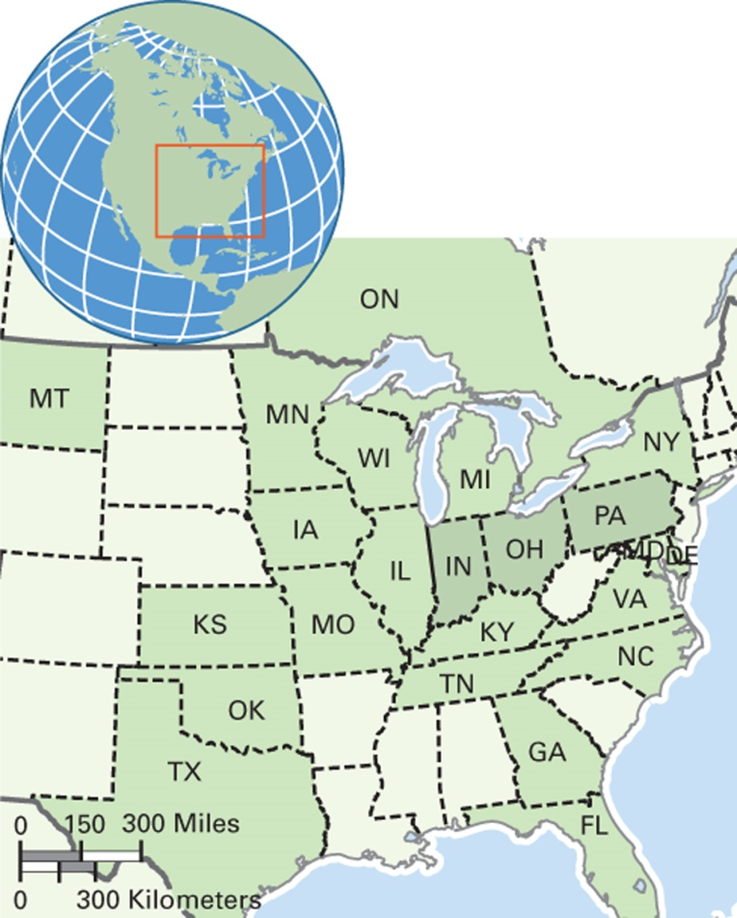
Map 6.1 Old Order Amish Population of North America
Notes:
Ohio, Pennsylvania, and Indiana have the largest number of Old Order Amish in the United States.

Slide 9
Culturama: The Old Order Amish of the United States and Canada (2 of 3)
Old Order Amish have high fertility rates
  Average 6 to 7 births per woman
  Overall population is doubling every 20 years
  Youth decide whether to be baptized into the faith at age 16; around 90 percent decide to accept Amish ways and be baptized
  Rumspringa is their opportunity to experience the English world

Slide 10
Culturama: The Old Order Amish of the United States and Canada (3 of 3)
Economic Change among the Old Order Amish
  Growing involvement in non-farming activities such as small businesses
  Cultural accommodation to business world by selling at home to keep family together
  Some working away, with the “English”

Slide 11
The Industrial/Digital Mode of Reproduction (1 of 2)
Follows the demographic transition
Below-replacement-level fertility in many contexts
Value of children: less

Slide 12
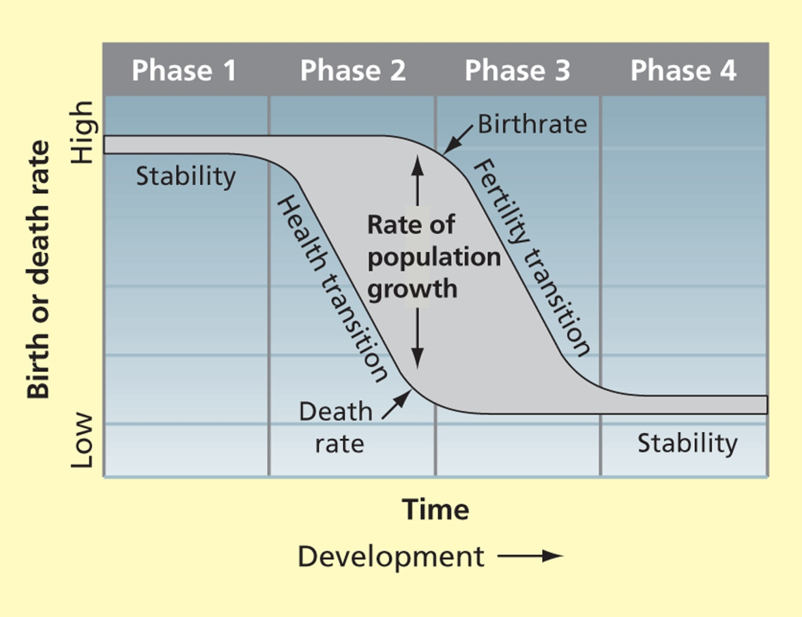
Figure 6.2 Model of the
Demographic Transition
Notes:
Source: Nebel, Bernard J.; Wright, Richard T.; Environmental Science: The Way The World Works, 7th edition. Copyright © 2000. Electronically reproduced by permission of Pearson Education, Inc. Upper Saddle River, New Jersey.

Slide 13
The Industrial/Digital Mode of Reproduction (2 of 2)
Three Characteristics
  Stratified reproduction
    Middle- and upper-class families have fewer children, but higher survival rates
    Among the poor, fertility and mortality rates are both high
  Population aging
  Importance of scientific knowledge and technology in managing reproduction

Slide 14
Culture and Fertility
6.2 Discuss how culture shapes fertility in different cultural contexts.
Sexual Intercourse
Fertility Decision Making
Fertility Control
Infanticide

Slide 15
Sexual Intercourse
When to Begin Having Intercourse?
  Menarche
  Menopause
Intercourse Frequency and Fertility
  Study comparing Euro-Americans in the United States and Hindus in India found frequency and fertility were not associated

Slide 16
Anthropology Works: Studying Sexual Behavior among MSM in New York City
Study of sex practices of men who have sex with men
Especially use or non-use of condoms
Use of interviews to provide qualitative insights

Slide 17
Fertility Decision Making (1 of 3)
At the Family Level
  Considerations for having children
    Children’s labor value
    Children’s value as old-age support for parents
    Infant and child mortality rates
    Economic costs of children

Slide 18
Fertility Decision Making (2 of 3)
At the State Level
  Economic factors, especially labor requirements
  Maintaining the tax base, military, ethnic and regional proportions
  Providing public services
  Dealing with population aging

Slide 19
Fertility Decision Making (3 of 3)
At the Global Level
  Religious teachings
  International relations and foreign aid (U.S. restrictions on aid to groups that perform abortions, and preference for abstinence programs)

Slide 20
Fertility Control
Indigenous Methods
  Study in Afghanistan found most practices were pronatal
Induced Abortion
  Governments may restrict or encourage
New Reproductive Technologies
  IVF

Slide 21
Infanticide
Most common reason is that infant is seriously ill or “deformed”
Process may be:
  Direct
  Indirect
    Food deprivation, failure to provide warm clothing

Slide 22
Personality and the Life Cycle (1 of 2)
6.3 Identify how culture shapes personality over the life cycle.
Birth, Infancy, and Childhood
Socialization During Childhood
Adolescence and Identity
Adulthood

Slide 23
Personality and the Life Cycle (2 of 2)
Personality
  An individual’s patterned and characteristic way of behaving, thinking, and feeling
  Gained largely through enculturation; variation in personality in different cultural contexts

Slide 24
Birth, Infancy, and Childhood (1 of 2)
Gender in Infancy
  Studies have focused on stereotypes associated with gender
    Infant males more aggressive, independent
    Infant females more social

Slide 25
Birth, Infancy, and Childhood (2 of 2)
  Observation: Males cry more than females
    Evidence of aggression?
    Or the result of a more difficult delivery because of body weight?
  Observation: Females smile more than males
    Females are innately more social?
    Or caretakers smile more at females?

Slide 26
Socialization During Childhood
Six Cultures Study
  Research on children’s behavior in six cultures
  Found difference between horticultural and industrial/digital sites:
    Horticulture: nurturant-responsible children
    Industrial/digital: dependent-dominant children
  Difference may be explained by mothers’ work roles

Slide 27
Adolescence and Identity (1 of 4)
Gender identity during adolescence
  Biological or culturally constructed?
  Cultural evidence:
    Adolescence not a universal stage
    Length of adolescence related to gender roles and mode of production

Slide 28
Adolescence and Identity (2 of 4)
Cultural construction of identity in rituals
  Coming of age rituals
    Initiation ceremonies
    Often involve body modification, including cutting, scarification
      Example: male circumcision among the Maasai

Slide 29
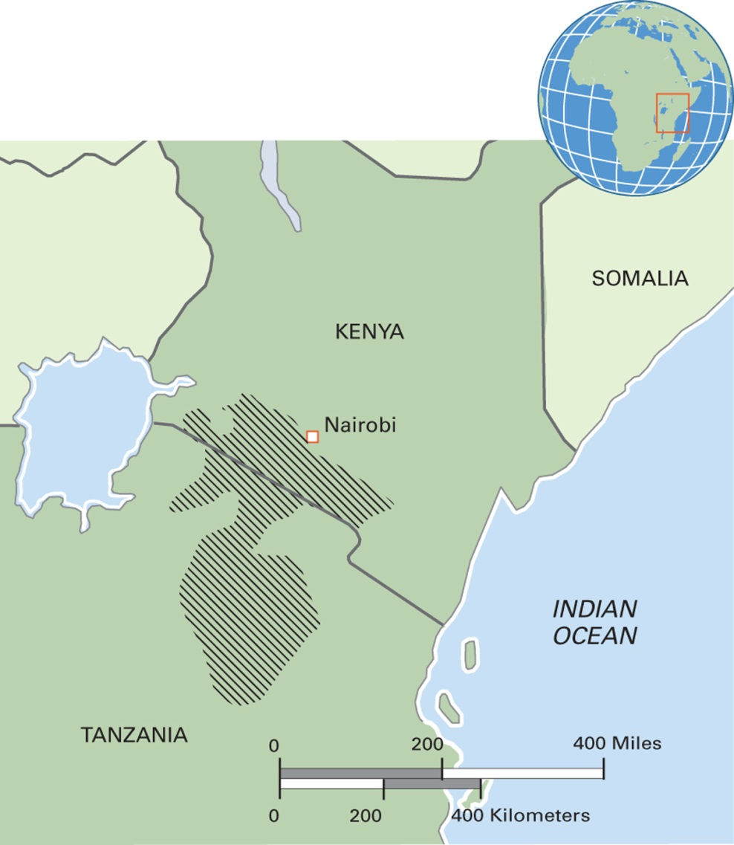
Map 6.4 Maasai Region of Kenya and Tanzania
Notes:
An estimated 350,000 Maasai live in Kenya and 150,000 in Tanzania. The climate is semiarid.

Slide 30
Adolescence and Identity (3 of 4)
Sexual Identity and Gender Pluralism
  Gender pluralism: the existence within a culture of multiple categories of femininity, masculinity, and androgyny that are tolerated and legitimate
  “Third genders”—some cultures permit the expression of varied forms of sexual orientation; for example, the berdache

Slide 31
Adolescence and Identity (4 of 4)
The two-spirit
  Indian tribal cultures in the United States and Canada more accepting of gender role fluidity than mainstream (White) culture is
  The institution of the two-spirit subjected to ridicule and disapproval from mainstream culture
  Since the 1980s, open presence of the two-spirit has returned in some tribal groups

Slide 32
Think Like an Anthropologist: Cultural Relativism and Female Genital Cutting (1 of 2)
Various types and degrees of cutting in various cultural contexts
Related to period of seclusion and training in adult roles and knowledge
Cultural construction of female identity, body, solidarity

Slide 33
Think Like an Anthropologist: Cultural Relativism and Female Genital Cutting (2 of 2)
Food for Thought
  Why is FGC a prominent issue in human rights debates in the West, whereas male circumcision and other forms of initiation are not?
  Where do you stand on FGC and why?
  What kinds of cultural remodeling of the female body are practiced in your culture?

Slide 34
Adulthood (1 of 2)
Parenthood
  Role of mother and father shaped by culture
  Responsibility for child care
    Example: paternal care of children among the Aka of the Central African Republic
Middle Age
  Midlife crisis and menopause: Western constructions?

Slide 35
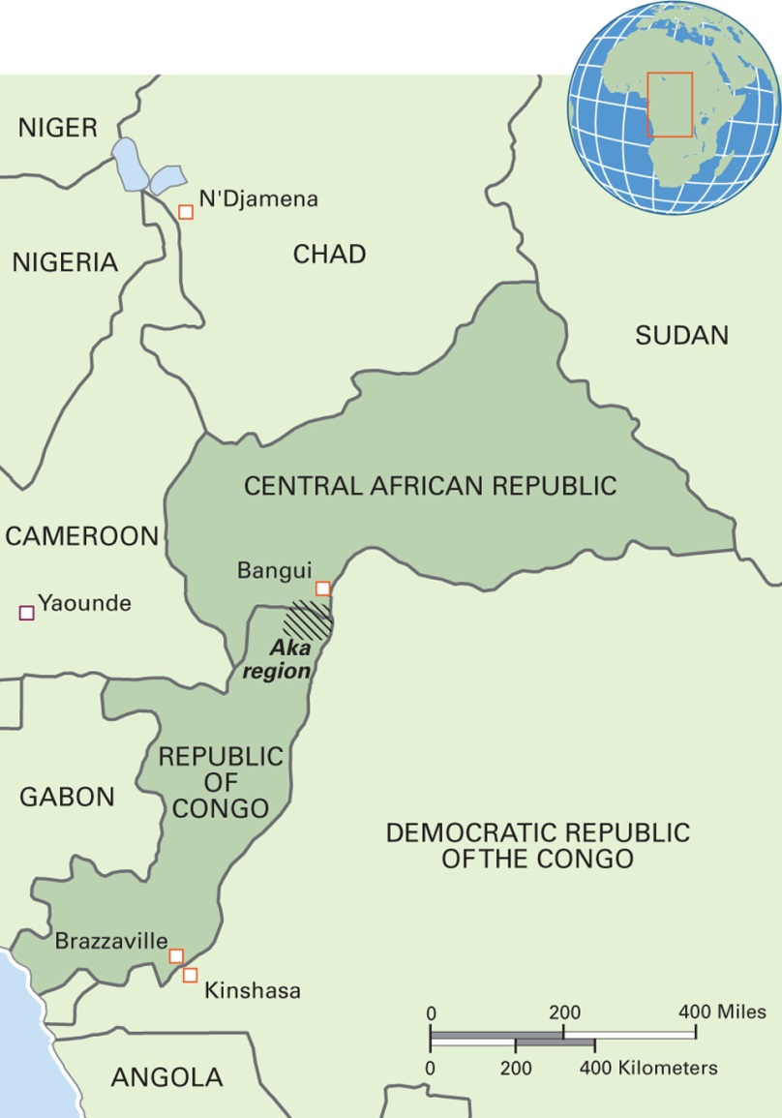
Map 6.7 Aka Region of the Central African Republic and the Democratic Republic of Congo
Notes:
The 30,000 Aka are tropical forest foragers who know hundreds of plants and animals. They eat roots, leaves, nuts, fruits, mushrooms, honey, grubs, caterpillars, and meat from monkeys, rats, mongooses, and porcupines. They trade meat to farmers for manioc and other cultivated foods. They are socially egalitarian, and their religious beliefs are indigenous. Diaka, their main language, is tonal. The Aka territory is critically endangered by commercial loggers.

Slide 36
Adulthood (2 of 2)
The Senior Years
  Cultural variation in status and care of elders
  Elders generally better off when they live with families rather than in institutions as in industrial/digital economy societies
The Final Passage: Death and Dying
  Culture shapes views of the “good death” and proper treatment of the body
  Cultural variation in expression of grief at loss of loved one

